Slide 1
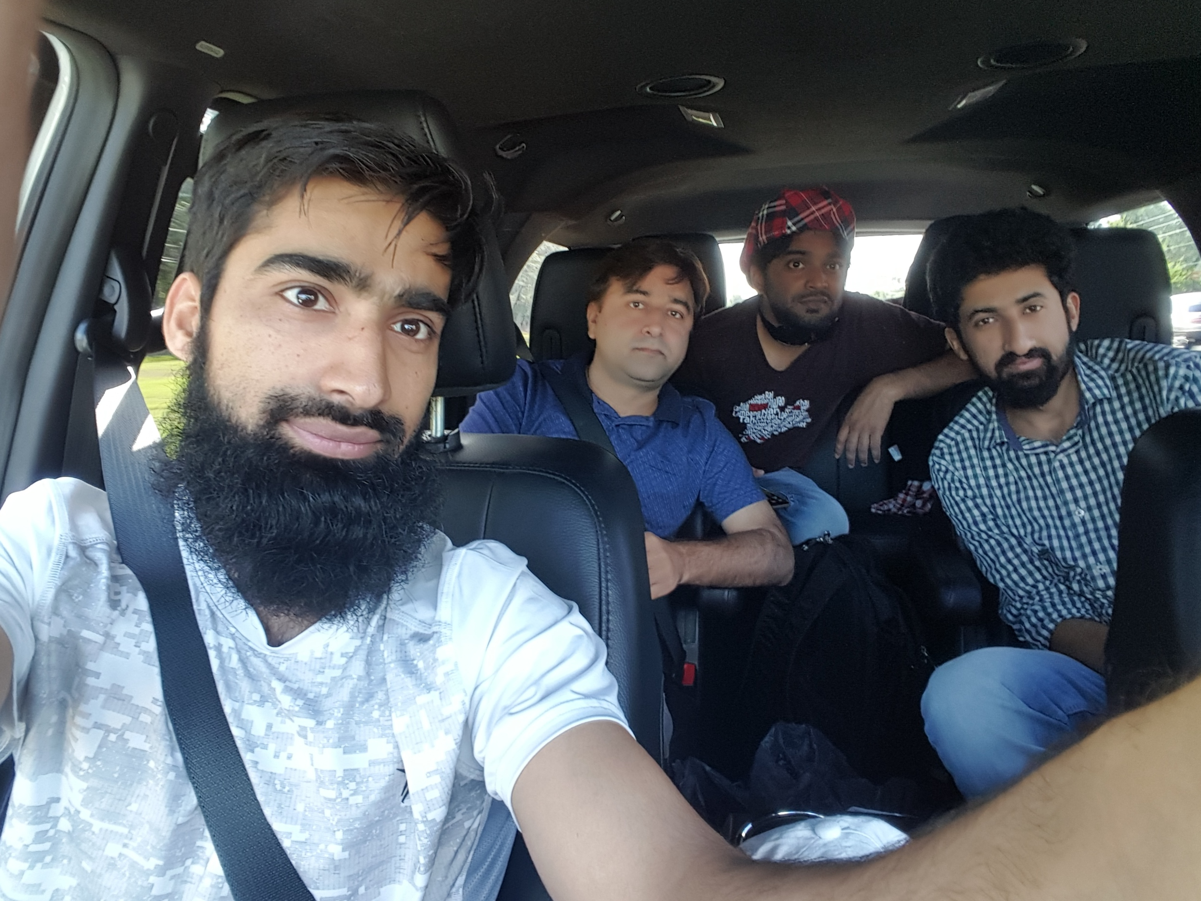
Dr. Sajid Iqbal
Department of Computer Science
Bahauddin Zakariya University, Multan

Slide 2
Lecture Contents
The Computation Process
How input devices work
Central Processing Unit
CPU History
System Clock
Read only Memory
CPU Speed
Types of Processors
CPU Cooling System

Slide 3
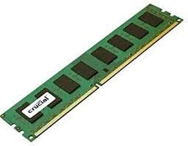

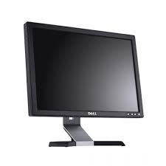
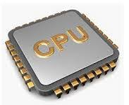
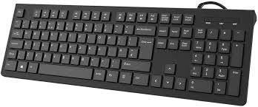
The Computation Process
The computer gets the input from input devices
Processes it using processing circuit
Produces output and displays to user

Slide 4

Input Devices
There are number of input devices that we can use with computer
Keyboard is the basic input device
Thanks to the YouTube video provider

Slide 5
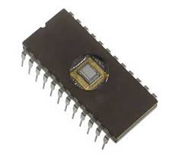
Persistent Storage Read only memory (ROM)
It is non-volatile memory used in computers and other electronic devices
A circuit can be made in a way then when specific input is provided to it, it produces same output
Input to ROM is fixed in hardware so it always produces same output when it is powered on
Data stored in ROM cannot be electronically modified after the manufacture of the memory device
Firmware: A software that is hardwired and can not be changed
Every computer contains a small firm ware using ROM called Basic Input Output System (BIOS)

Slide 6
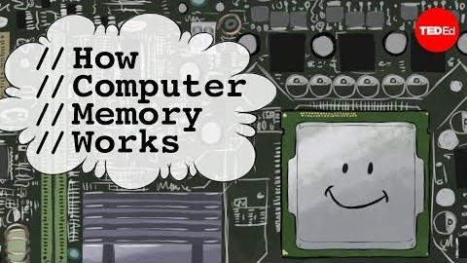
How Computer Memory Works

Slide 7
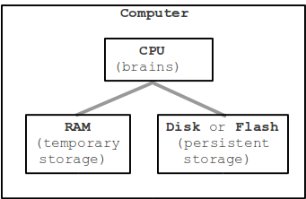

Central Processing Unit (CPU)
CPU - Central Processing Unit
Acts like a brain: follows the instructions in the code
"general" - images, networking, math .. all on the CPU
Performs computations, e.g. add two numbers
RAM Stores temporary data (for the duration, the system is on)
Storage stores the data for long time even system is off
CPU Speed
It is measured in hertz (system clock cycles per second)
Roughly each clock cycles performs one basic instruction
A 1-Giga (${10}^{9}$) hertz system can perform ${10}^{9}$ instruction in a second

Slide 8
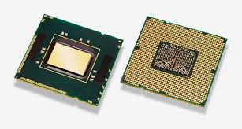
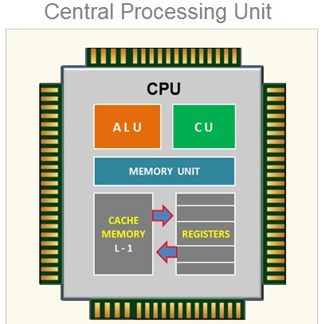

Central Processing Unit
Arithmetic Logic Unit (ALU)
It can perform the arithmetic ($+,−$) and logic (<,>,=) operations
Control Unit (CU)
It controls the operation of ALU, tell the ALU what to do
Memory Unit
This stores instructions and results temporarily
Cache
This part stores the instructions and data communicated with RAM for faster processing
Registers
These are small memory areas used for different purposes

Slide 9
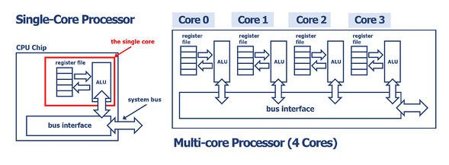
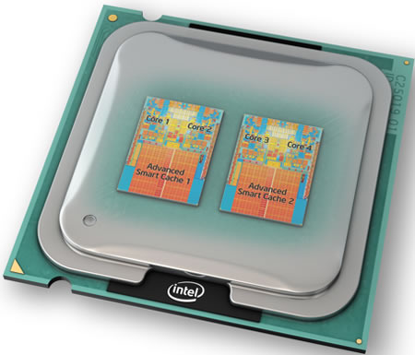
CPU and Cores
Modern CPU chips have multiple "cores"
Each core is a semi-independent CPU
Usually more cores, more faster the CPU is
However the fact is not true beyond a specific number of cores

Slide 10
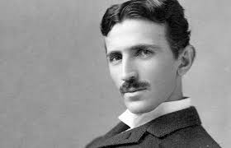
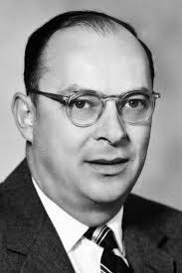
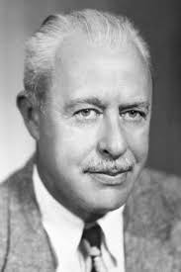
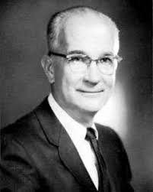
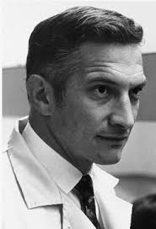
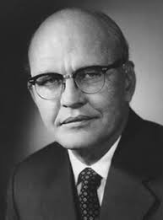
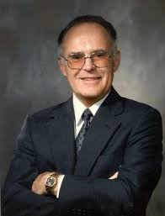
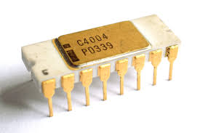
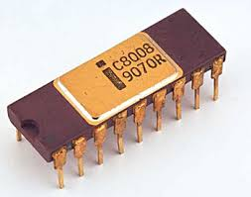
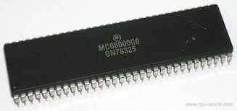
CPU History
Year | Event
1903 | Nikola Tesla patented electrical logic circuits called "gates" or "switches" in 1903.
1947 | John Bardeen, Walter Brattain, and William Shockley invent the first transistor at the Bell Laboratories on December 23, 1947.
1958 | The first working integrated circuit was developed by Robert Noyce of Fairchild Semiconductor and Jack Kilby of Texas Instruments.
1968 | Intel Corporation was founded by Robert Noyce and Gordon Moore in 1968.
1969 | AMD (Advanced Micro Devices) was founded on May 1, 1969.
1971 | First microprocessor introduced by intel known as Intel 4004
1972 | Intel introduced the 8008 processor
1979 | The Motorola 68000, a 16/32-bit processor was released and was later chosen as the processor for the Apple Macintosh
Data Source

Slide 11
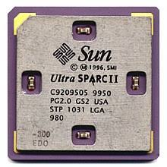
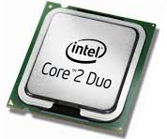
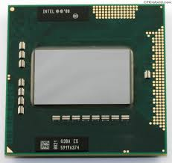
CPU History
Year | Event
1987 | The SPARC processor was first introduced by Sun.
1989 | Cyrix released their first coprocessors, the FasMath 83D87 and 83S87, in 1989
… | Battle of processor improvement among different companies
2006 | Intel released the Core 2 Duo processor E6320 (4 M cache, 1.86 GHz, 1066 MHz FSB) on April 22, 2006.
2007 | Intel released the Core 2 Quad processor Q6600
2009 | Intel released the first Core i7 mobile processor
… | Battle of better and more powerful processors
2018 | Intel released the first Core i9 mobile processor
For more detailed information

Slide 12
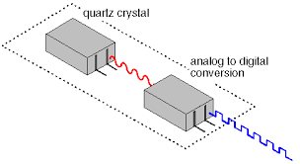
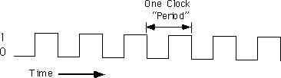
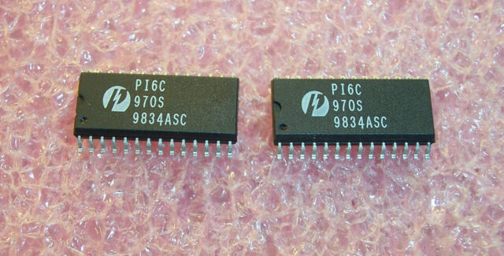
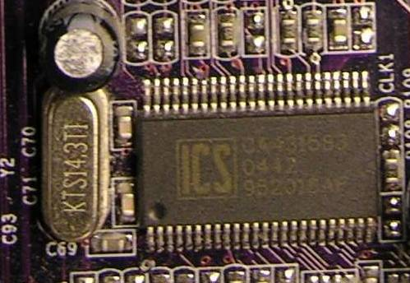
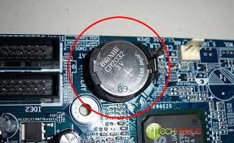
System Clock Generator
An electronic device in a computer that issues a steady high-frequency signal that synchronizes all the internal components
It is located at mother board
Clock speed is measured in hertz i.e. MHz, GHz
Usually faster the clock, higher the speed of computer

Slide 13
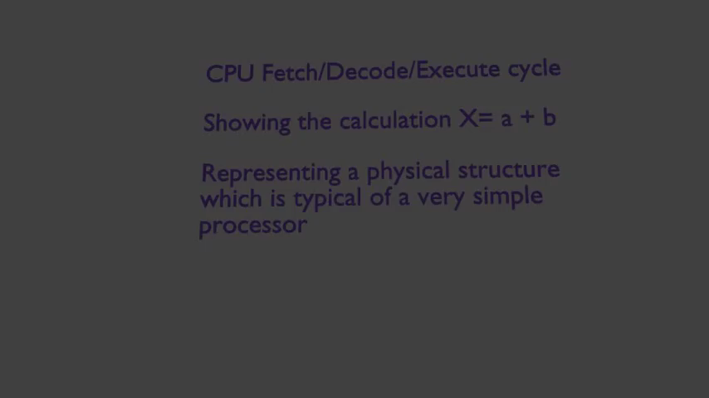
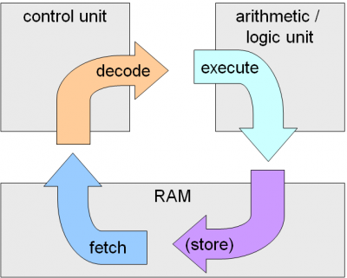
CPU Speed
Clock speed controls the speed of CPU
When a clock signal (tick) comes, CPU fetches an instruction and executes it
A processor usually has speed of few GHz i.e. 3.2GHz

Slide 14
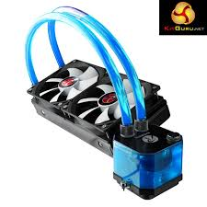
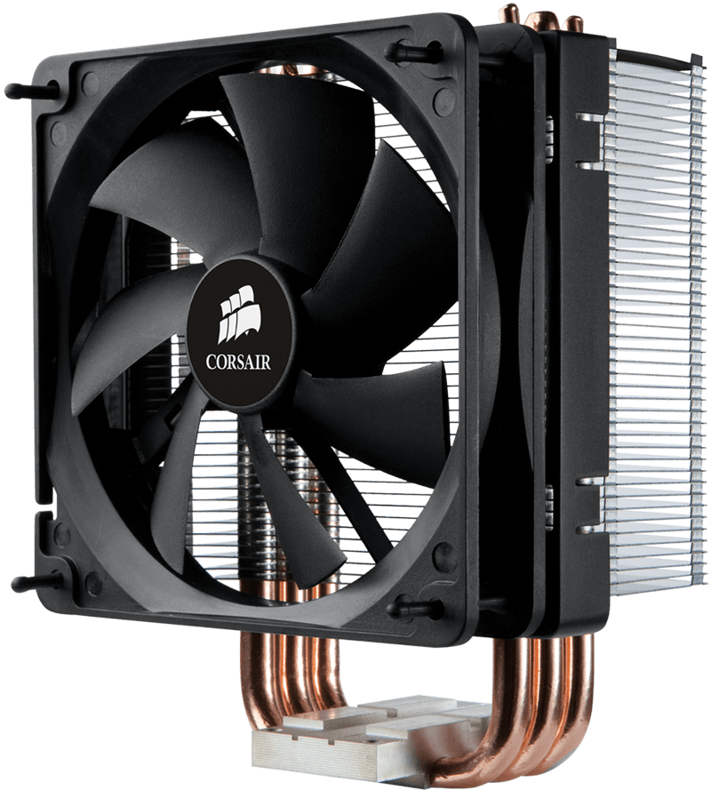
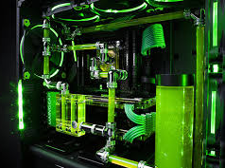
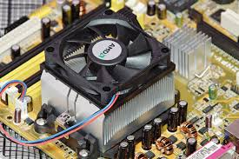
CPU Cooling System
Due to power consumption, the electronic components produce the heat
All integrated circuits produce the heat i.e. CPU, GPU, VGA, Sound Card
Usually CPU works most so it produces most heat
CPU cooling system
Air Cooling: A fan is used on processor to cool it
Liquid Cooling: It is usually used in large systems and takes more space

Slide 15
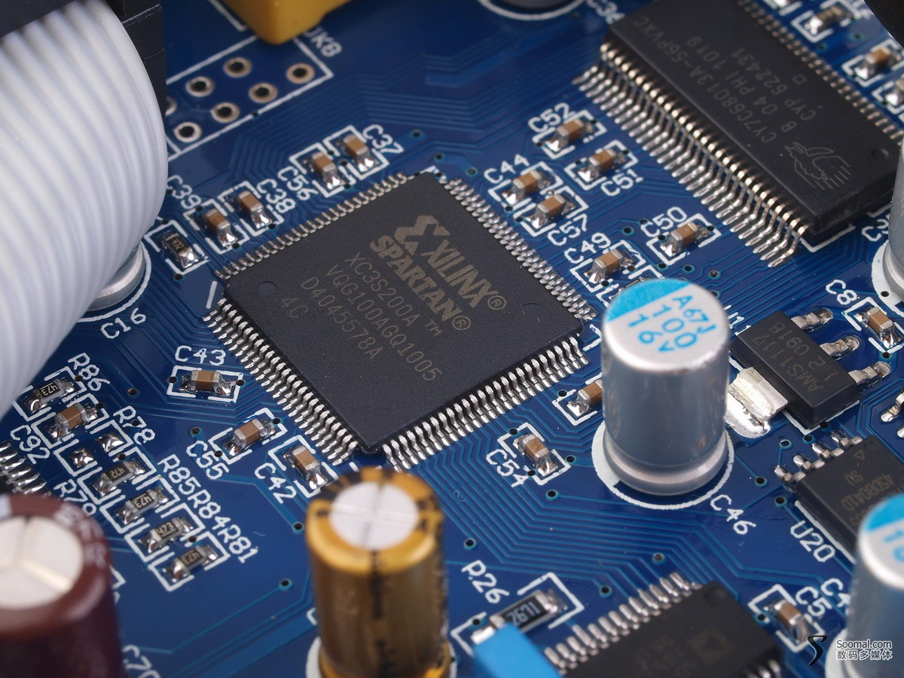
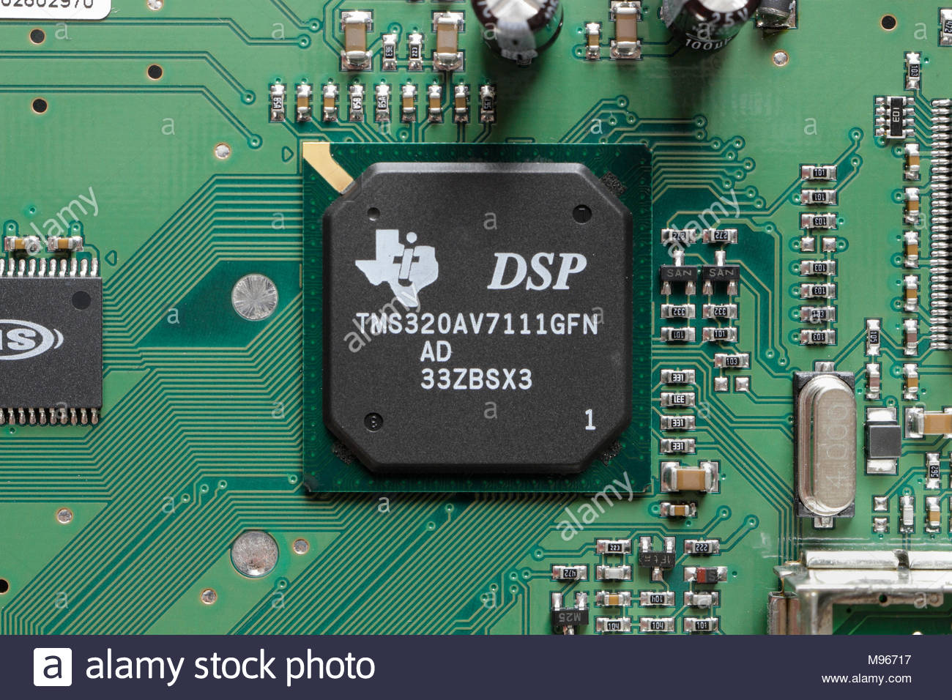
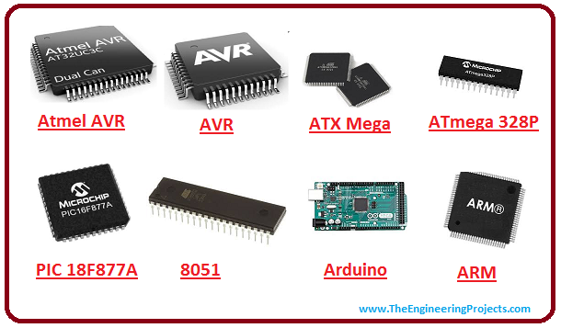
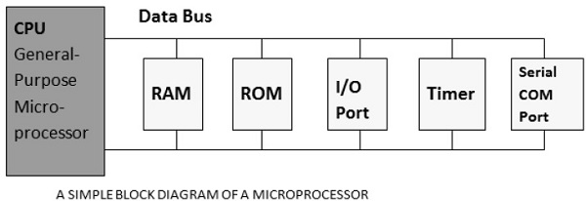
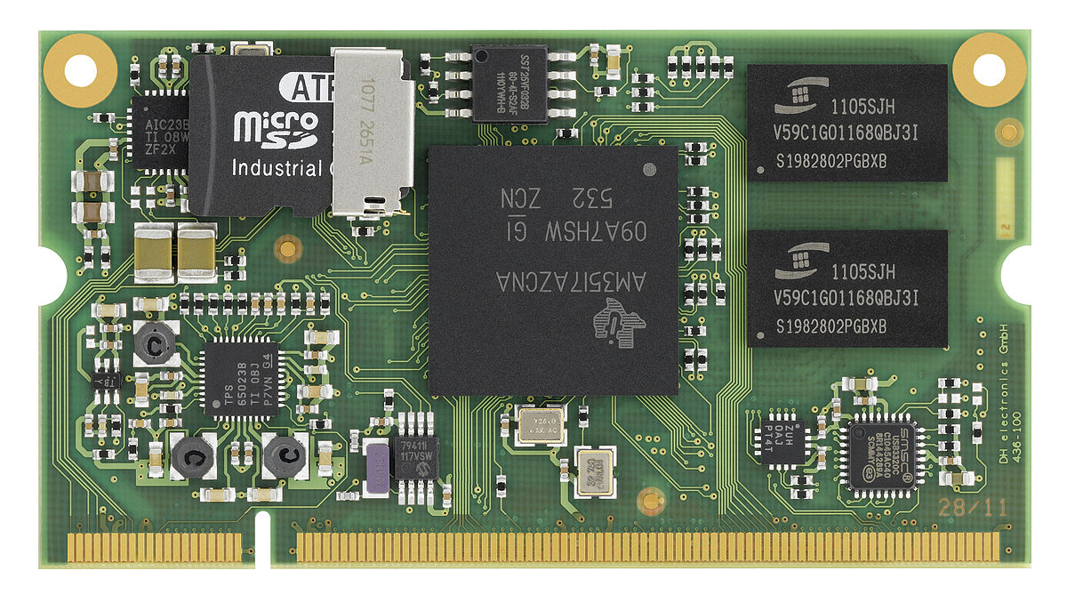
Types of Processors
General purpose processors (GPP)
A general purpose processor is not specific for a particular task. It can perform multiple tasks
Microprocessor
Microcontroller
Embedded Processor
Digital Signal Processor
Media Processor

Slide 16
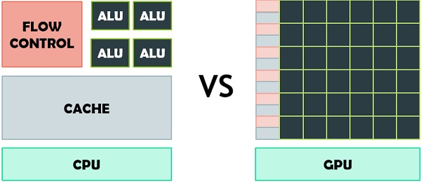
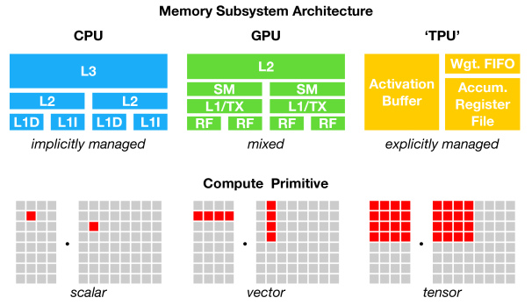
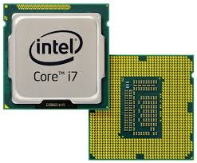
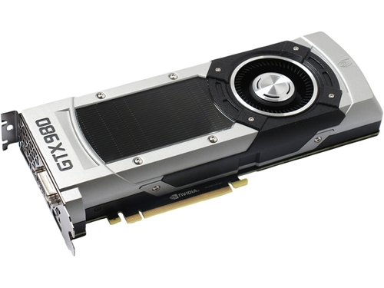
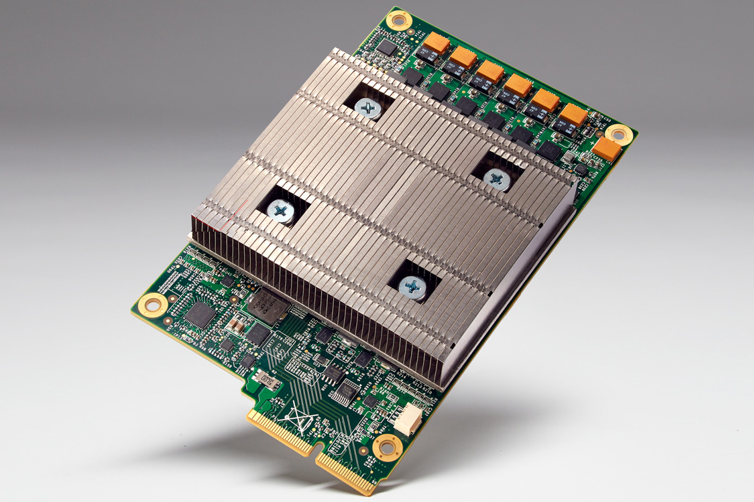
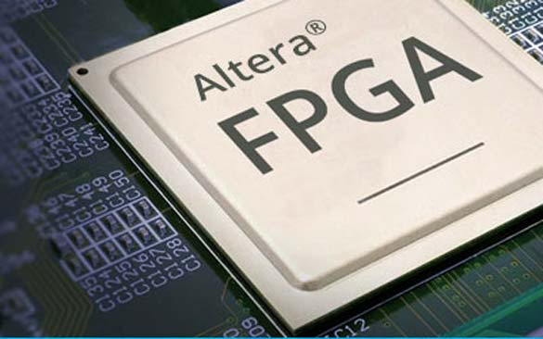
Types of Processors
Special purpose processors (SPP)
Specialized processors entertain and keep us connected
Application Specific System Processor (ASSP)
Application Specific Instruction Processors (ASIPs)
Graphic Processing Units (GPU)
Modern GPUs have more ALUs
Field programmable graphics array (FPGA)

Slide 17



Thanks for watching
Dr. Sajid Iqbal
Assistant Professor
Department of Computer Science
Bahauddin Zakariya University, Multan
sajidiqbal.pk@gmail.com
https://github.com/sajjo79/Introduction-to-Computers
Allah Hafiz
COMEDXD

